Slide 1
Edge / Boundary Detection

Slide 2
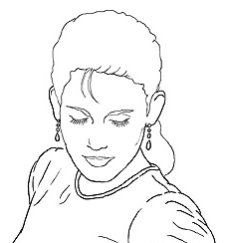
Edge detection
Goal: Identify sudden changes (discontinuities) in an image
Intuitively, most semantic and shape information from the image can be encoded in the edges
More compact than pixels
Ideal: artist’s line drawing (but artist is also using object-level knowledge)
Source: D. Lowe

Slide 3
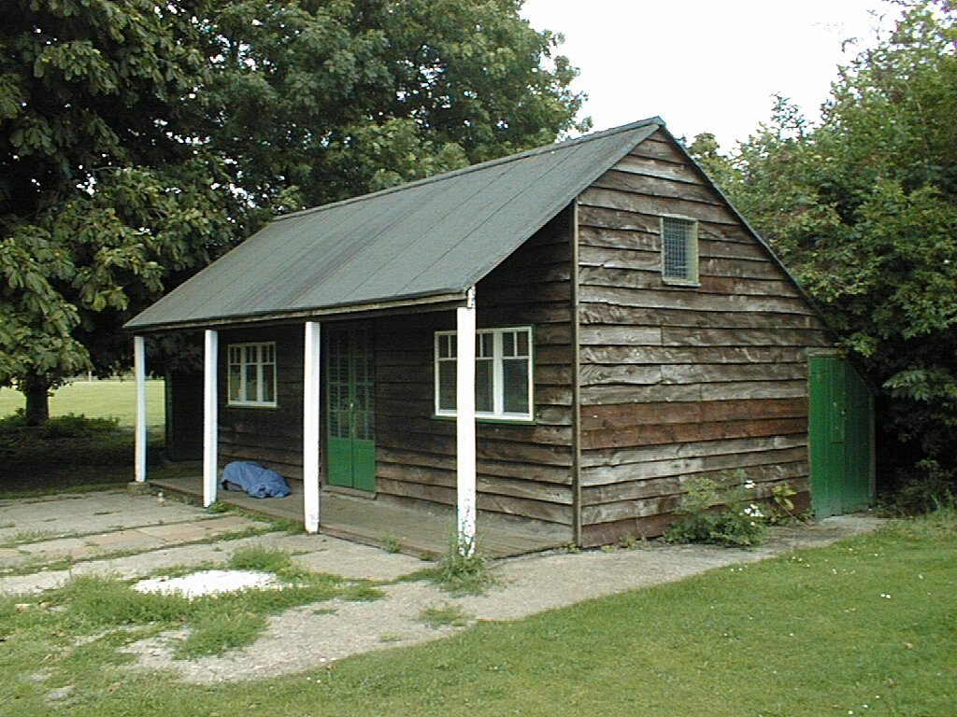
Why do we care about edges?
Extract information, recognize objects
Recover geometry and viewpoint
Vertical vanishing
point
(at infinity)
Vanishing
line
Vanishing
point
Vanishing
point

Slide 4
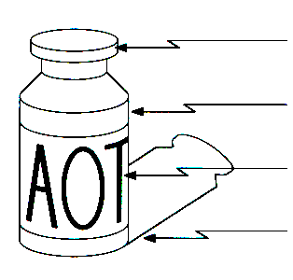
Origin of Edges
Edges are caused by a variety of factors
surface normal discontinuity
depth discontinuity
surface color discontinuity
illumination discontinuity
Source: Steve Seitz

Slide 5
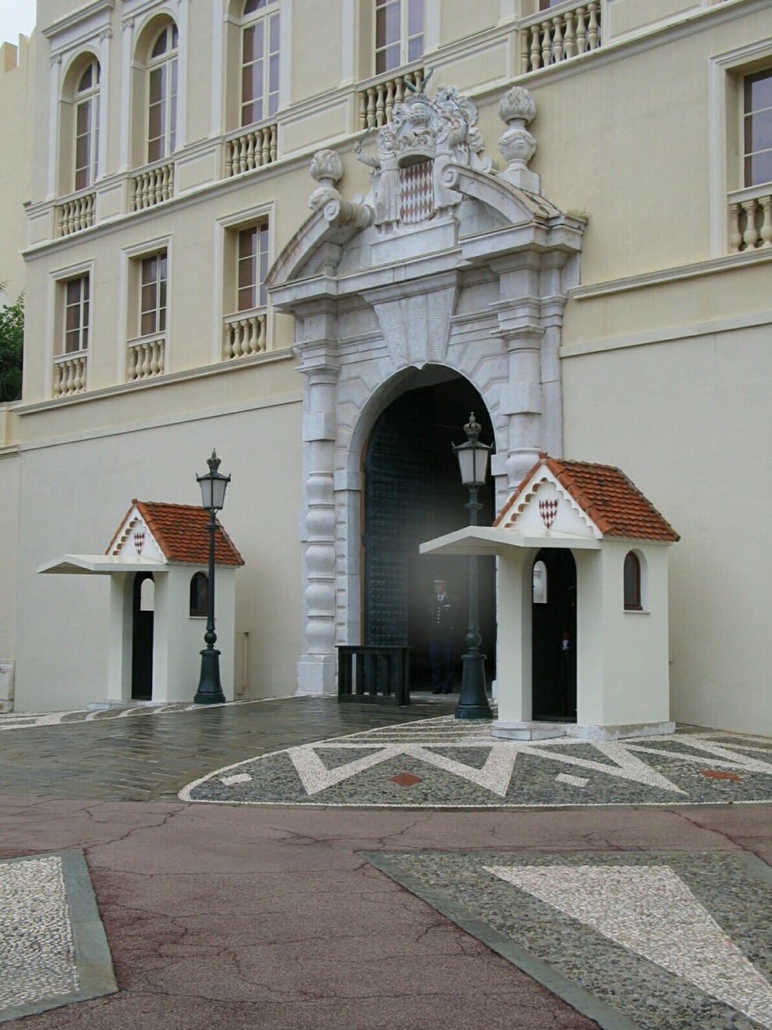
Closeup of edges
Source: D. Hoiem

Slide 6
Closeup of edges
Source: D. Hoiem

Slide 7
Closeup of edges
Source: D. Hoiem

Slide 8
Closeup of edges
Source: D. Hoiem

Slide 9

Characterizing edges
An edge is a place of rapid change in the image intensity function
intensity function (along horizontal scanline)
image
first derivative
edges correspond to extrema of derivative

Slide 10
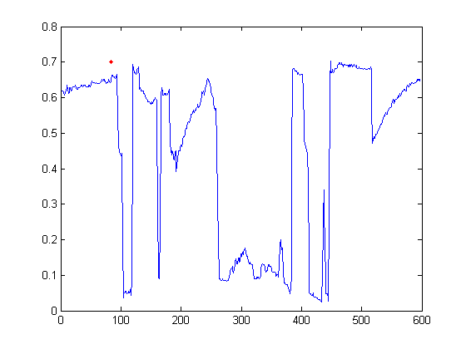

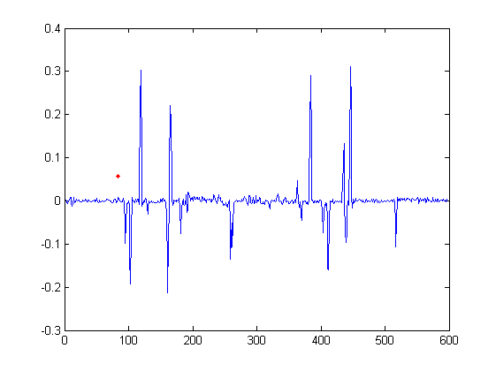
Intensity profile
Source: D. Hoiem

Slide 11
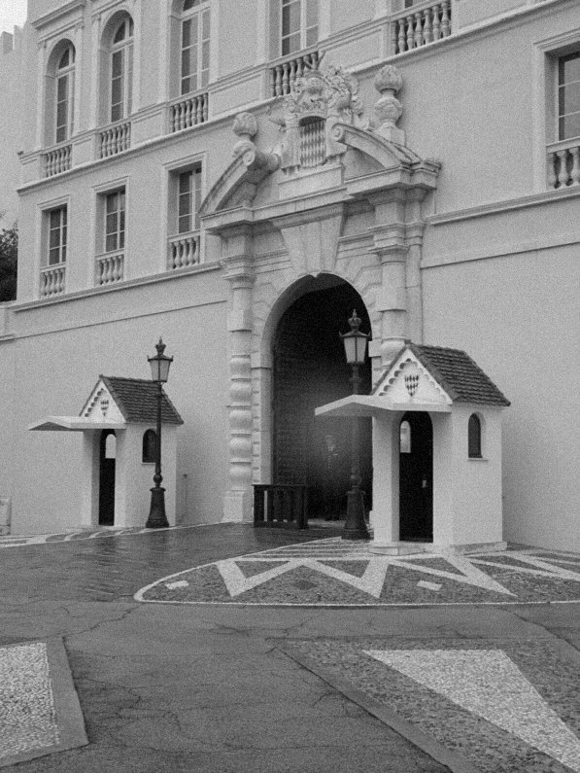
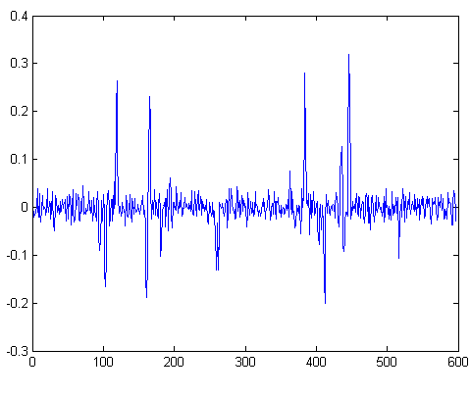
With a little Gaussian noise
Gradient
Source: D. Hoiem

Slide 12
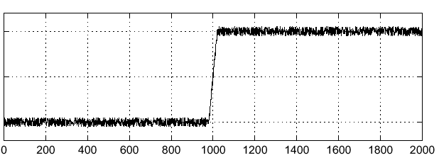
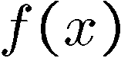
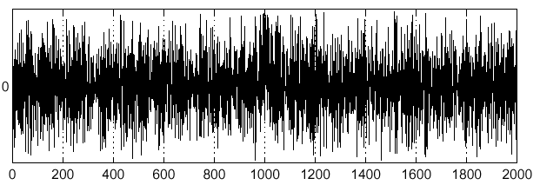
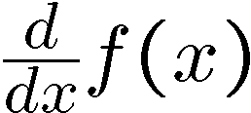
Effects of noise
Consider a single row or column of the image
Plotting intensity as a function of position gives a signal
Where is the edge?
Source: S. Seitz
Notes:
How to fix?

Slide 13
Effects of noise
Difference filters respond strongly to noise
Image noise results in pixels that look very different from their neighbors
Generally, the larger the noise the stronger the response
What can we do about it?
Source: D. Forsyth

Slide 14
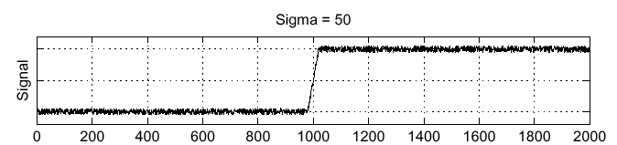
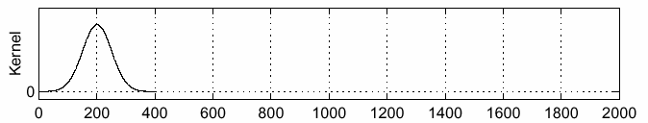
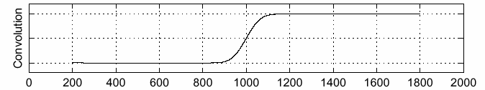
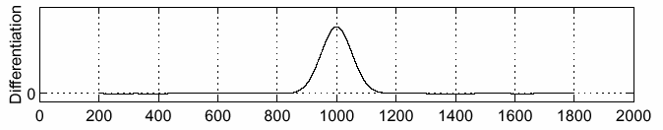
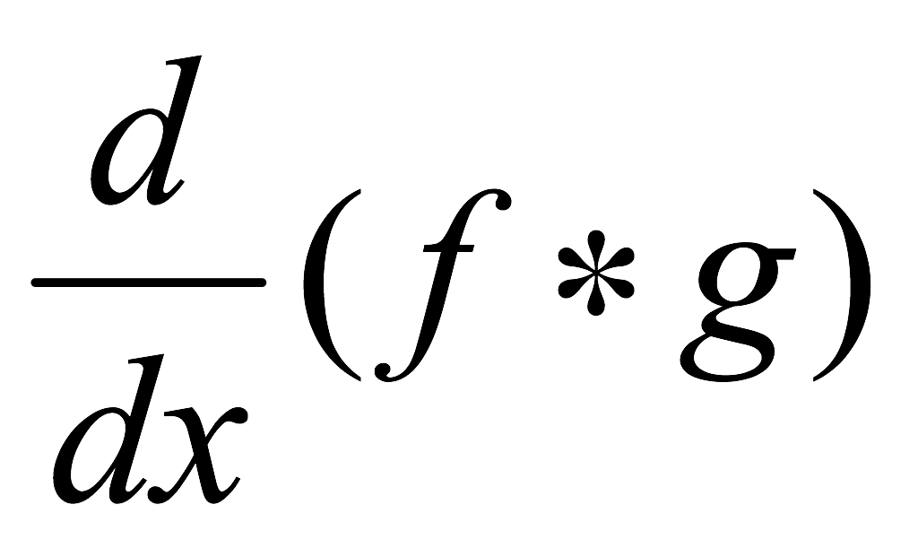
Solution: smooth first
f
g
f * g
To find edges, look for peaks in
Source: S. Seitz

Slide 15
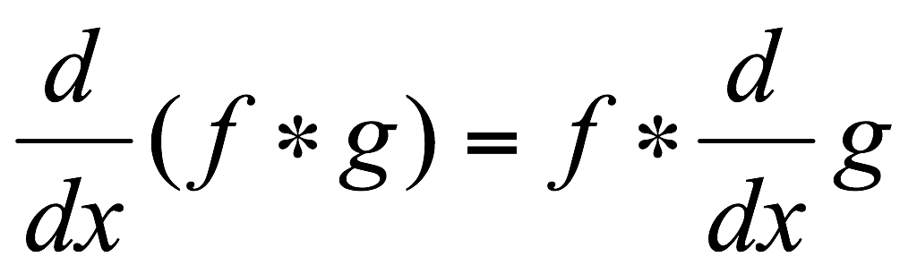
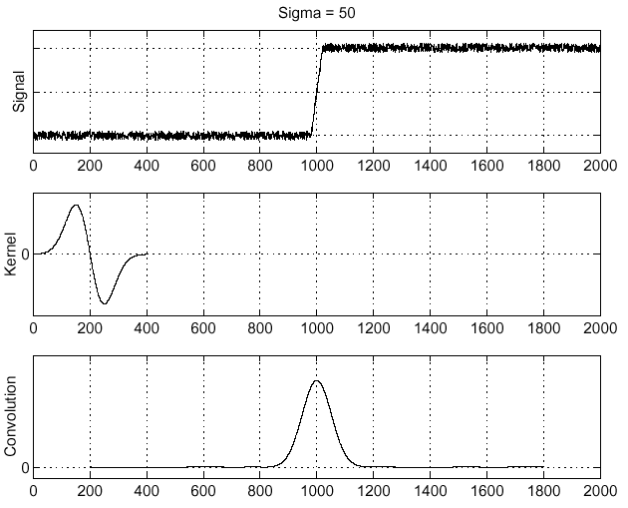
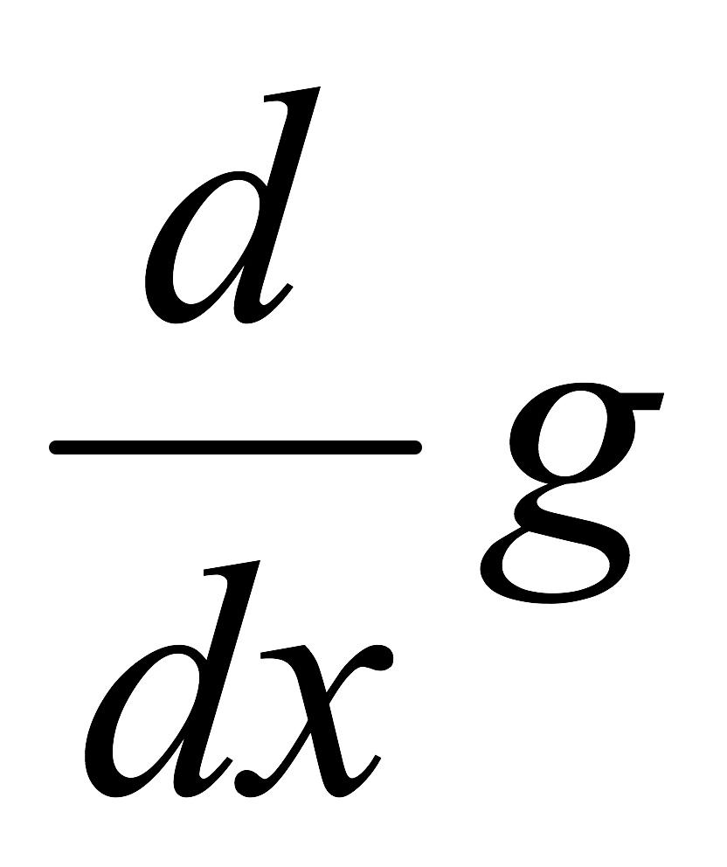
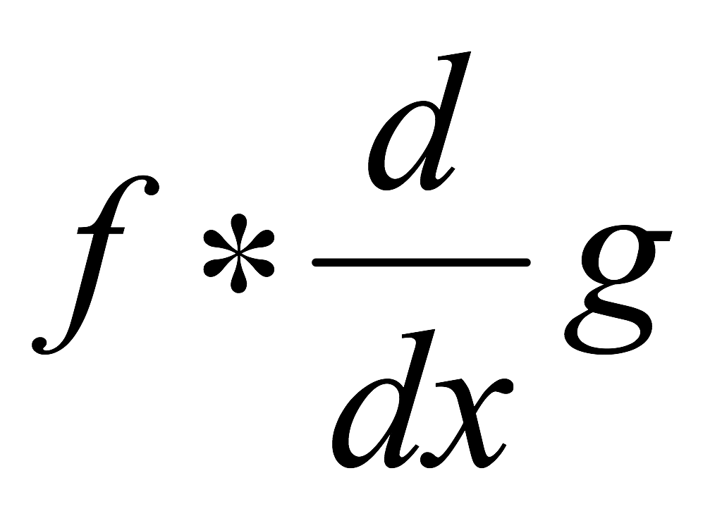
Derivative theorem of convolution
Differentiation is convolution, and convolution is associative:
This saves us one operation:
f
Source: S. Seitz

Slide 16
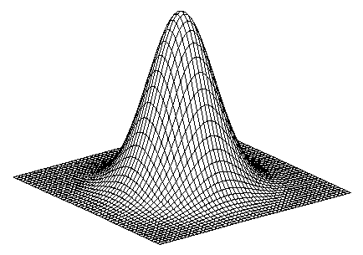
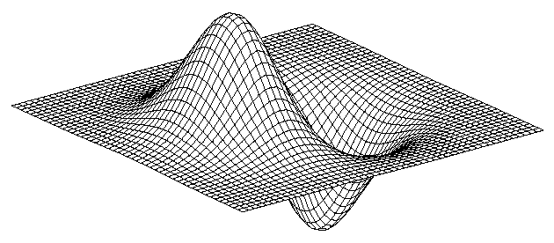
Derivative of Gaussian filter
* [1 -1] =
Notes:
Is this filter separable?

Slide 17
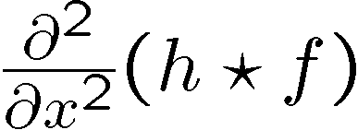

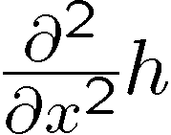
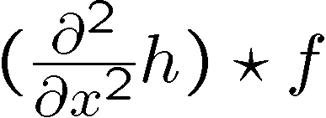
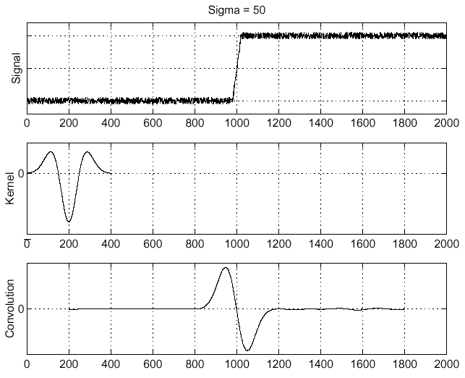
Laplacian of Gaussian
Consider
Laplacian of Gaussian
operator
Where is the edge?
Zero-crossings of bottom graph

Slide 18
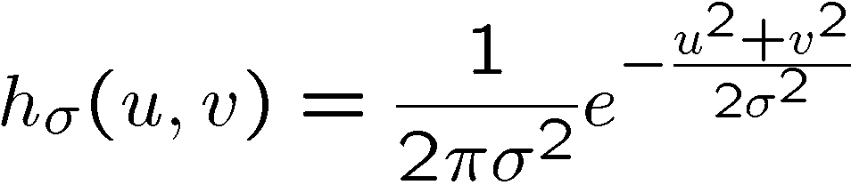
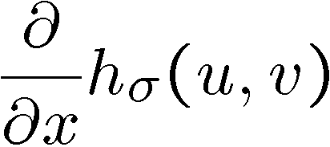
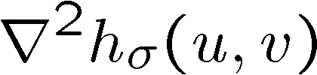
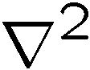
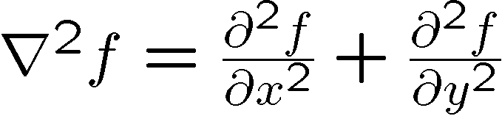
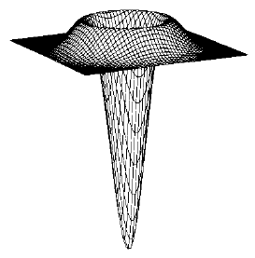
2D edge detection filters
Laplacian of Gaussian
Gaussian
derivative of Gaussian
is the Laplacian operator:

Slide 19
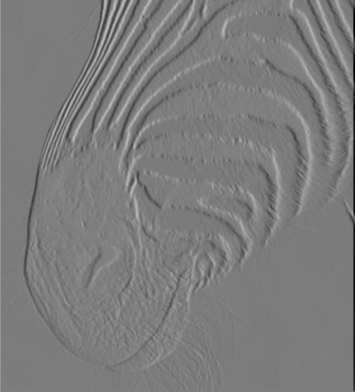
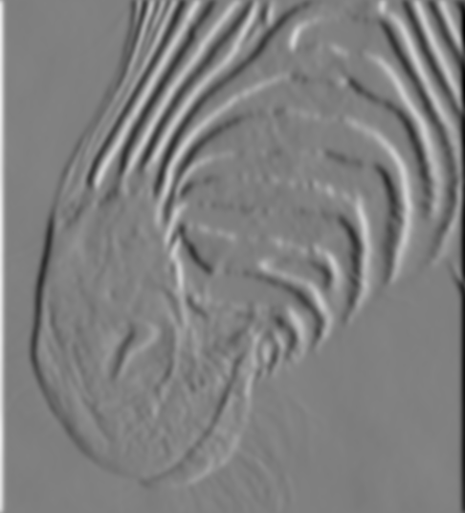

Tradeoff btw smoothing and localization
Smoothed derivative removes noise, but blurs edge. Also finds edges at different “scales”.
1 pixel
3 pixels
7 pixels
Source: D. Forsyth

Slide 20
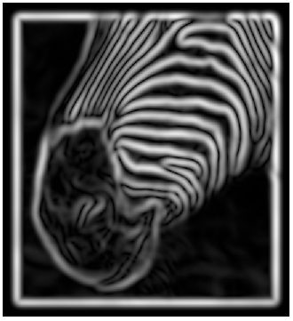
Implementation issues
The gradient magnitude is large along a thick “trail” or “ridge,” so how do we identify the actual edge points?
How do we link the edge points to form curves?
Source: D. Forsyth
Notes:
Figures show gradient magnitude of zebra at two different scales

Slide 21
Designing an edge detector
Criteria for a good edge detector:
Good detection: the optimal detector should find all real edges, ignoring noise or other artifacts
Good localization
the edges detected must be as close as possible to the true edges
the detector must return one point only for each true edge point
Cues of edge detection
Differences in color, intensity, or texture across the boundary
Continuity and closure
High-level knowledge
Source: L. Fei-Fei

Slide 22
Canny edge detector
This is probably the most widely used edge detector in computer vision
Theoretical model: step-edges corrupted by additive Gaussian noise
Canny has shown that the first derivative of the Gaussian closely approximates the operator that optimizes the product of signal-to-noise ratio and localization
J. Canny, A Computational Approach To Edge Detection, IEEE Trans. Pattern Analysis and Machine Intelligence, 8:679-714, 1986.
Source: L. Fei-Fei

Slide 23
Note about Matlab’s Canny detector
Small errors in implementation
Gaussian function not properly normalized
First filters with a Gaussian, then a difference of Gaussian (equivalent to filtering with a larger Gaussian and taking difference)

Slide 24

Example
original image (Lena)

Slide 25
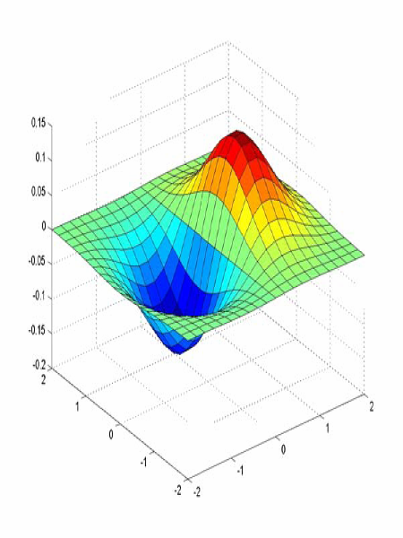
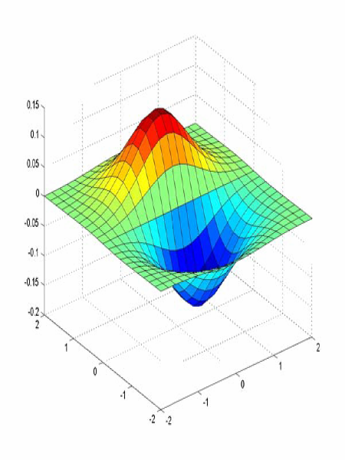
Derivative of Gaussian filter
x-direction
y-direction

Slide 26
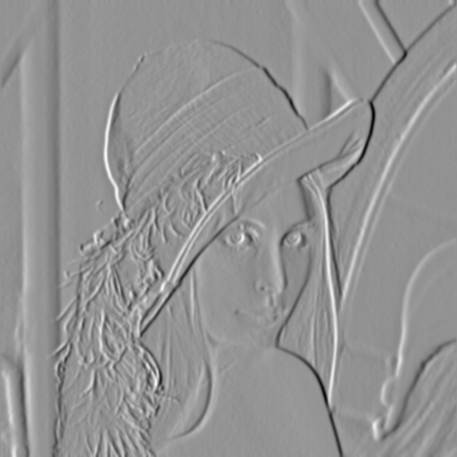
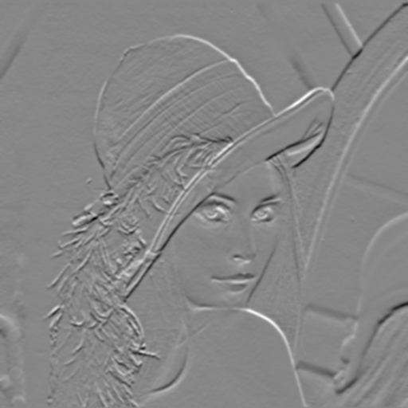
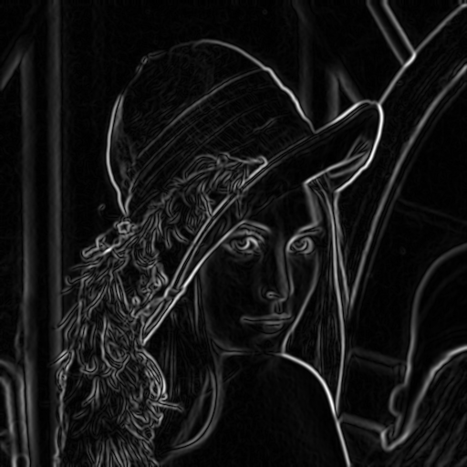
Compute Gradients (DoG)
X-Derivative of Gaussian
Y-Derivative of Gaussian
Gradient Magnitude

Slide 27
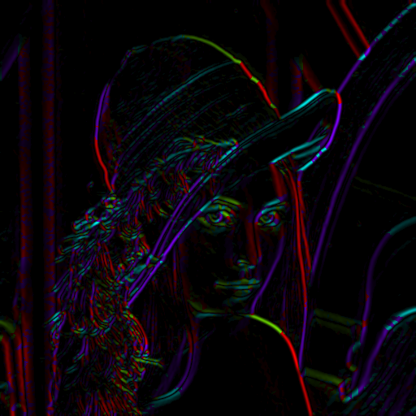
Get Orientation at Each Pixel
Threshold at minimum level
Get orientation
theta = atan2(gy, gx)

Slide 28
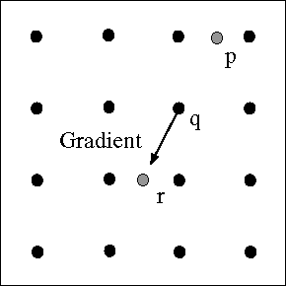


Non-maximum suppression for each orientation
At q, we have a maximum if the value is larger than those at both p and at r. Interpolate to get these values.
Source: D. Forsyth

Slide 29
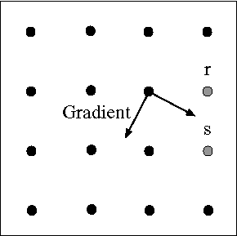
Edge linking
Assume the marked point is an edge point. Then we construct the tangent to the edge curve (which is normal to the gradient at that point) and use this to predict the next points (here either r or s).
Source: D. Forsyth

Slide 30
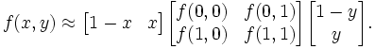
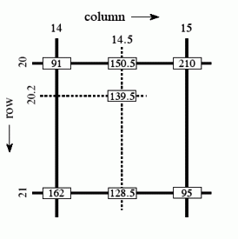
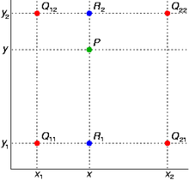
Sidebar: Bilinear Interpolation
http://en.wikipedia.org/wiki/Bilinear_interpolation

Slide 31
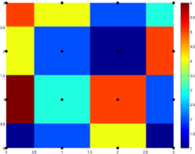
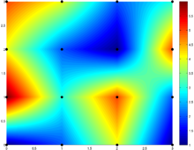
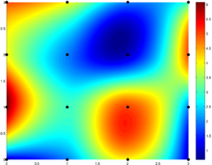
Sidebar: Interpolation options
imx2 = imresize(im, 2, interpolation_type)
‘nearest’
Copy value from nearest known
Very fast but creates blocky edges
‘bilinear’
Weighted average from four nearest known pixels
Fast and reasonable results
‘bicubic’ (default)
Non-linear smoothing over larger area (4x4)
Slower, visually appealing, may create negative pixel values
Examples from http://en.wikipedia.org/wiki/Bicubic_interpolation

Slide 32
Before Non-max Suppression

Slide 33

After non-max suppression

Slide 34
Before Non-max Suppression

Slide 35

After non-max suppression

Slide 36

Hysteresis thresholding
Threshold at low/high levels to get weak/strong edge pixels
Do connected components, starting from strong edge pixels

Slide 37
Hysteresis thresholding
Check that maximum value of gradient value is sufficiently large
drop-outs? use hysteresis
use a high threshold to start edge curves and a low threshold to continue them.
Source: S. Seitz

Slide 38

Final Canny Edges

Slide 39
Canny edge detector
Filter image with x, y derivatives of Gaussian
Find magnitude and orientation of gradient
Non-maximum suppression:
Thin multi-pixel wide “ridges” down to single pixel width
Thresholding and linking (hysteresis):
Define two thresholds: low and high
Use the high threshold to start edge curves and the low threshold to continue them
MATLAB: edge(image, ‘canny’)
OpenCV: Canny( src, dst, lowThreshold, highTreshold, kernel_size )
It needs Gaussian, first
Source: D. Lowe, L. Fei-Fei

Slide 40





Effect of σ (Gaussian kernel spread/size)
original
Canny with
Canny with
The choice of σ depends on desired behavior
large σ detects large scale edges
small σ detects fine features
Source: S. Seitz

Slide 41
Lines

Slide 42

Edges are not lines

Slide 43
Finding lines in an image
Option 1:
Search for the line at every possible position/orientation
What is the cost of this operation?
Option 2:
Use a voting scheme: Hough transform

Slide 44

The basic idea
Each straight line in this image can be described by an equation
Each white point if considered in isolation could lie on an infinite number of straight lines

Slide 45
The basic idea
Each straight line in this image can be described by an equation
Each white point if considered in isolation could lie on an infinite number of straight lines

Slide 46
The basic idea
Each straight line in this image can be described by an equation
Each white point if considered in isolation could lie on an infinite number of straight lines
In the Hough transform each point votes for every line it could be on
The lines with the most votes win

Slide 47

How do we represent lines?
Conventional representation
$y=mx+b$
A line is parameterized by $m$ and $b$
Problems?
More general way
$ax+by+c=0 ⟹\overline{x}∙\tilde{l}=0$
A line is represented by $a$, $b$, and $c$
Problem: $a$, $b$, and $c$ are “homogenous”
Better way
Normalization: $l=\left({\hat{n}}_{x},{\hat{n}}_{y},d\right)=\left(\cos{θ,}\sin{θ},d\right)$
Now we can represent a line with $(d,θ)$

Slide 48




How do we represent lines?
Here we will represent the yellow line by $(d,θ)$
In other words we define it using
a line from an agreed origin
of length $d$
at angle $θ$ to the horizontal
$$x\cos{θ}+y\sin{θ}=d$$
$$θ$$
$$d$$

Slide 49








Hough space
$$θ$$
$$d$$
Since we can use $(d,θ)$ to represent any line in the image space
We can represent any line in the image space as a point in the plane defined by $(d,θ)$
This is called Hough space
$$θ=0$$
$$θ=180$$
$d=0$ $d=100$

Slide 51









How does a point in image space vote?
$$x\cos{θ}+y\sin{θ}=d$$
$$θ=0$$
$$θ$$
$$d$$
$$θ=180$$
For a $θ$
For another $θ$
$d=0$ $d=100$

Slide 52
Magnified

Slide 53


How do multiple points prefer one line?
One point in image space
corresponds to a sinusoidal curve in image space
Two points
correspond to two curves in Hough space
The intersection of those two curves
“two votes”
This intersection represents
the straight line in image space that passes through both points

Slide 54
Magnified

Slide 55

Hough Transform
Create $θ$ and $d$ for all possible lines
Create an array A indexed by $θ$ and $d$ and set to zero
for each edge point (x,y)
for each angle $θ$
$d$ = x*cos($θ$)+ y*sin($θ$)
H[$θ$, $d$] += 1
end
end
where A > Threshold return a line

Slide 56



A simple example
$$θ$$
$$d$$

Slide 57

Extensions
Extension 1: Use the image gradient
for each edge point (x,y)
compute unique ($d$,$θ$) based on image gradient at (x,y)
H[$θ$, $d$] += 1
end
What’s the running time measured in votes?
Extension 2
give more votes for stronger edges
Extension 3
change the sampling of (d, θ) to give more/less resolution

Slide 58

Circle Hough Transform
${\left(x−a\right)}^{2}+{\left(y−b\right)}^{2}=r^{2}$
for each edge point (x,y)
for all possible r
compute a and b
H[a,b,r]+=1
Find the value(s) of (a, b, r) where H[a, b, r] is maximum
The detected circle in the image is given by ${\left(x−a\right)}^{2}+{\left(y−b\right)}^{2}=r^{2}$

Slide 59
Assignment #2
Counting Coins
Detect edges of coins
Find a circle fitting each coin
Draw the circles on the image
Print the number of coins

Slide 60
Challenge #1
Business card rectification
Find edges
Find important lines
Compute four corners
Get the 2D perspective transform
onto some rectangle
Warp the input image

